Slide 1

Discrete
Fourier Transform
 | TOPIC
1 | Introduction to DTFT and DFT
2 | Relation between DFT and DTFT
3 | Properties of DFT
4 | DFT computation using DFT properties
5 | Linear and Circular Convolution using DFT
Kiran TALELE 99870 30 881 kiran.talele@spit.ac.in
‹#›

Slide 2
Kiran TALELE
@ Bharatiya Vidya Bhavans’ Sardar Patel Institute of Technology Andheri(w) Mumbai
Associate Professor, Electronics Engineering Department (1997)
Dean, Students, Alumni & External Relations (2022)
@ Sardar Patel Technology Business Incubator(SP-TBI),
Funded by Department of Science & Technology(DST),
Govt. of India
Coordinator (2015)
@ IEEE Bombay Section
Treasurer (2020)
Executive Committee Member (2015)
Kiran TALELE
‹#›

Slide 3


D F T
Dr. Kiran TALELE
 99870 30 881

Slide 4
Chapter-2 : Discrete Fourier Transform
Objective : To explore the properties of DFT in mathematical problem solving
Outcome :
At the end of module, students will be able to ,
Derive DFT from DTFT
Covert signal from time domain to frequency domain
Justify the need of DFT
Evaluate DFT and IDFT equations,
Apply DFT properties in problem solving
Perform Linear and Circular Convolution using DFT.
‹#›
Kiran TALELE 99870 30 881 kiran.talele@spit.ac.in
‹#›

Slide 5
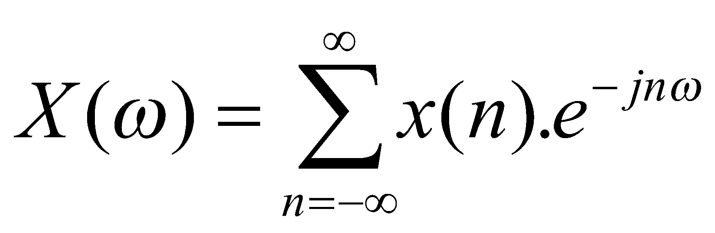
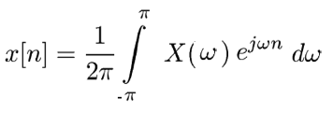
Discrete Time Fourier Transform (DTFT)
(1) DTFT of DT signal x[n] is defined as ,
(2) Inverse DTFT of X(w) is is defined as ,
‹#›
Kiran TALELE 99870 30 881 kiran.talele@spit.ac.in
‹#›

Slide 6
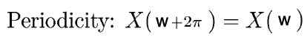
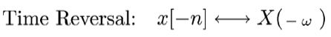
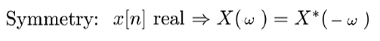
Properties of DTFT
Kiran TALELE 99870 30 881 kiran.talele@spit.ac.in
‹#›

Slide 7
Limitations of DTFT
DTFT is
Not practical for (real-time)
computation on a digital computer
Solution: Limit the extent of the summation to N points and evaluate the continuous function of frequency at N equi-spaced points.
Kiran TALELE 99870 30 881 kiran.talele@spit.ac.in
‹#›

Slide 8
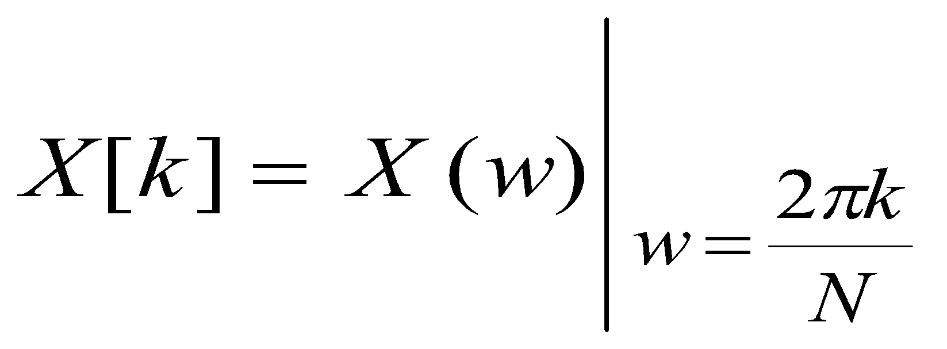

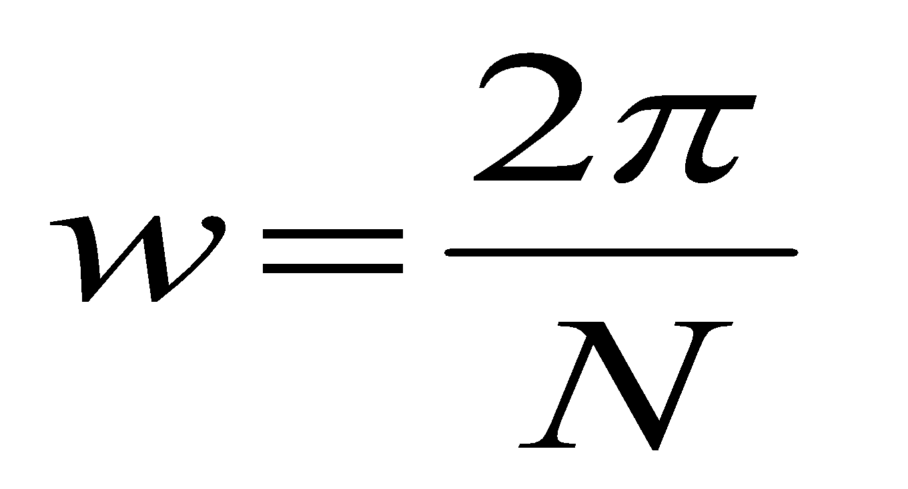
Relation between DFT and DTFT.
DFT is frequency Sampling of DTFT
Frequency spacing
The DFT is simply a sampling of the DTFT at equi spaced points along the frequency axis.
Kiran TALELE 99870 30 881 talelesir@gmail.com

Slide 9
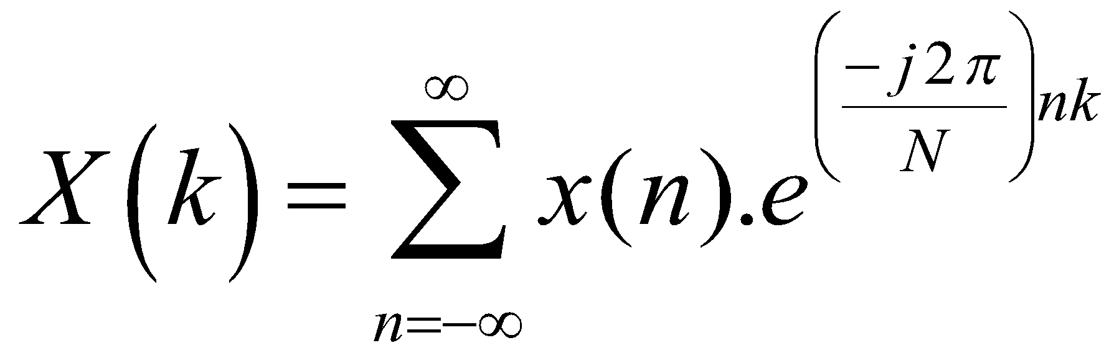
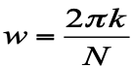
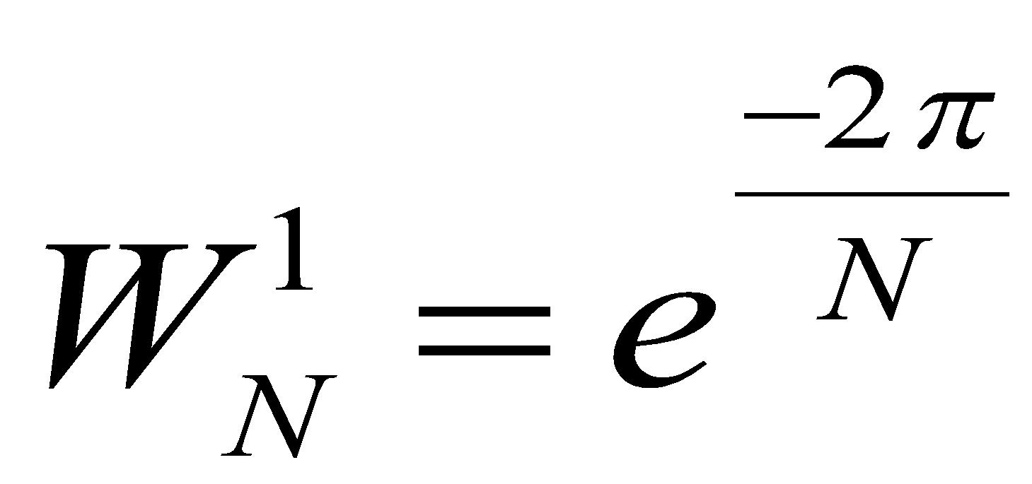
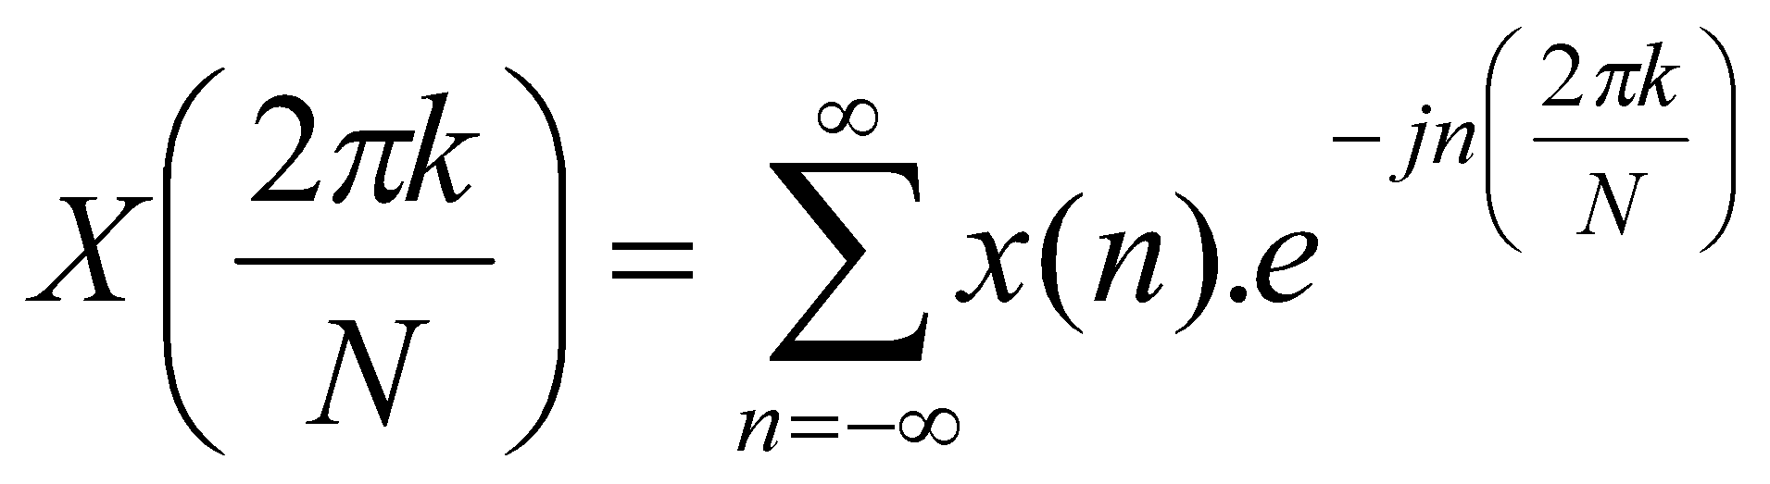
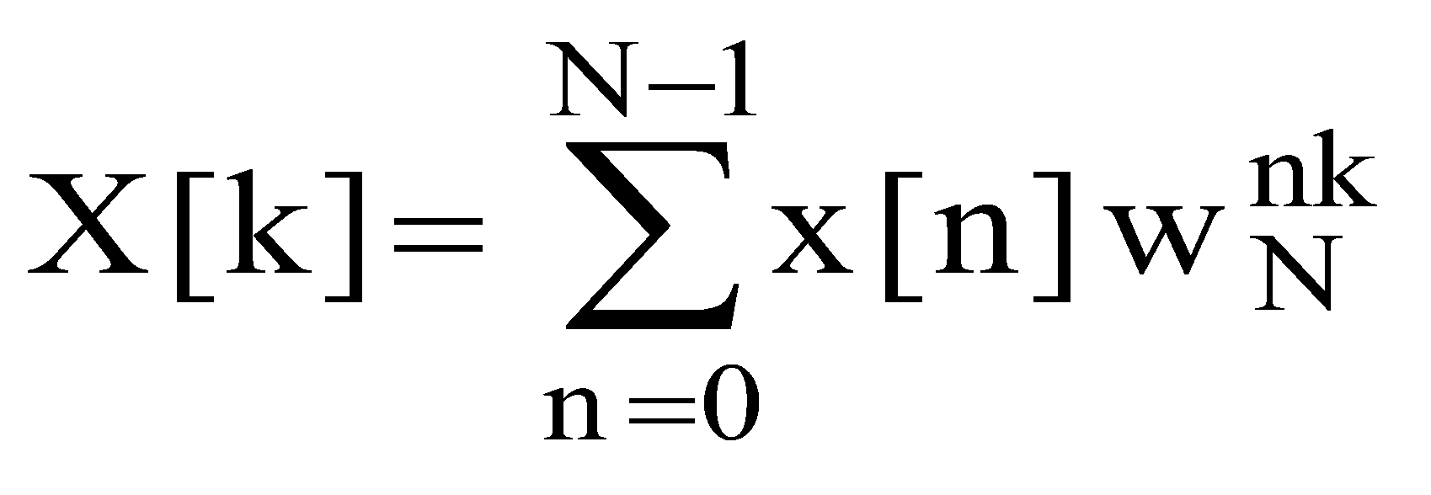
Dreivation of DFT equation
By DTFT,
Put
Put
‹#›
Kiran TALELE 99870 30 881 kiran.talele@spit.ac.in
‹#›

Slide 10
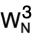
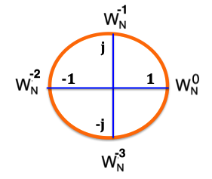
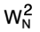
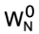

Cyclic Property of Twiddle factor W_{N}
Twiddle factor W_{N} is periodic with period = N
(1) Twiddle factor W_{N} for N = 4 :
j
-1
1
-j
‹#›
Kiran TALELE 99870 30 881 kiran.talele@spit.ac.in
‹#›

Slide 11
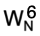
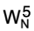
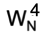
(2) Twiddle factor W_{N}^{k} for N = 8
= 1
= 0.707- j 0.707
= -j
j
= -0.707 – j 0.707
-1
1
= -1
= -0.707 + j 0.707
-j
= j
= 0.707 + j 0.707
‹#›
Kiran TALELE 99870 30 881 kiran.talele@spit.ac.in
‹#›

Slide 12
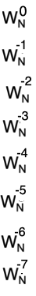
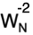
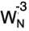
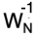
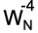
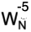
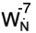
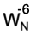
(3) Twiddle factor W_{N}^{-k} for N = 8
= 1
= 0.707 + j 0.707
= j
j
= -0.707 + j 0.707
= -1
-1
1
= -0.707 - j 0.707
= -j
-j
= 0.707 - j 0.707
‹#›
Kiran TALELE 99870 30 881 kiran.talele@spit.ac.in
‹#›

Slide 13
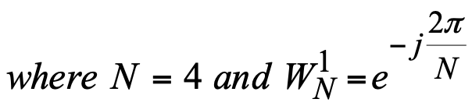
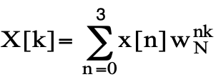
Ex-1. Let x[n] = { 1, 2, 3, 4 } Find X[k]
Solution :
To Find X[k]
By DFT,
Kiran TALELE 99870 30 881 kiran.talele@spit.ac.in
‹#›

Slide 14
X[k] = X[0] + X[1] W_{N}^{k} + X[2] W_{N}^{2k} + X[3] W_{N}^{3k}
X[k] = 1+ 2 W_{N}^{k} + 3 W_{N}^{2k} + 4 W_{N}^{3k}
(i) X[0] = 1 + 2 + 3 + 4
= 10
j
(ii) X[1] = 1 + 2 W_{N}¹ + 3 W_{N}² + 4 W_{N}³
= 1 + 2(–j) + 3(-1) + 4( j )
X[1] = –2 + 2j
-1
1
-j
(iii) X[2] = 1 + 2 W_{N}² + 3 W_{N}⁴ + 4 W_{N}⁶
= 1 + 2(–1) + 3(1) + 4(–1)
X[2] = –2
X[k] =
10 k=0
-2+2j
-2
-2-2j
(iv) X[3] = 1 + 2 W_{N}³ + 3 W_{N}⁶ + 4 W_{N}⁹
= 1 + 2(j) + 3(–1) + 4(–j)
X[3] = –2–2j
‹#›
Kiran TALELE 99870 30 881 kiran.talele@spit.ac.in
‹#›

Slide 15
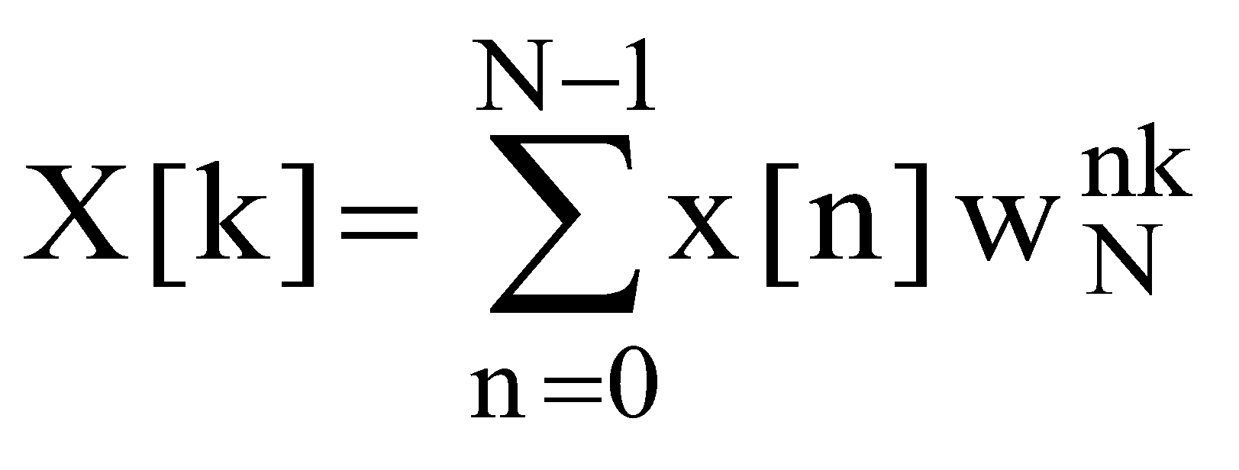
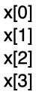
Matrix Representation of DFT and Inverse DFT
Let x[n] = { 1, 2, 3, 4 }
By DFT,
X[k] = x[0] W_{N}⁰ + x[1] W_{N}^{k} + x[2] W_{N}^{2k} + x[3] W_{N}^{3k}
In Matrix Form :
k=0
X[0]
==
W_{N}⁰ W_{N}⁰ W_{N}⁰ W_{N}⁰
k=1
X[1]
W_{N}⁰ W_{N}¹ W_{N}² W_{N}³
k=2
X[2]
W_{N}⁰ W_{N}² W_{N}⁴ W_{N}⁶
k=3
X[3]
W_{N}⁰ W_{N}³ W_{N}⁶ W_{N}⁹
X[k]
DFT Matrix
x[n]
Kiran TALELE 99870 30 881 kiran.talele@spit.ac.in
‹#›

Slide 16
By Substituting :
X[k] =
1 1 1 1
1
2
3 4
j
1 -j -1 j
1 -1 1 -1
-1
1
1 j -1 -j
-j
X[k] =
(1) + (2) + (3) + (4)
(1) + (-2j) + (-3) + (4j)
(1) + (-2) + (3) + (-4j)
(1) + (2j) + (-3) + (-4j)
X[k] =
10 k=0
-2+2j
-2
-2-2j
ANS
🡺
Kiran TALELE 99870 30 881 kiran.talele@spit.ac.in
‹#›

Slide 17
Ex-1. Let x[n] = { 1, 2, 3, 2 } Find X[k]
Solution :
To Find X[k]
By DFT,
Kiran TALELE 99870 30 881 kiran.talele@spit.ac.in
‹#›

Slide 18
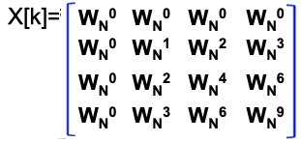
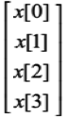
In Matrix Form :
X[k] =
(1) + (2) + (3) + (2)
(1) + (-2j) + (-3) + (2j)
(1) + (-2) + (3) + (-2)
(1) + (2j) + (-3) + (-2j)
By Substituting :
Ans :
X[k] =
1 1 1 1
1
2
3 2
X[k] =
1 -j -1 j
8 k=0
-2
0
-2
1 -1 1 -1
1 j -1 -j
‹#›
Kiran TALELE 99870 30 881 kiran.talele@spit.ac.in
‹#›

Slide 19
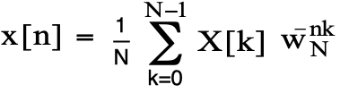
X[k] =
10 k=0
-2+2j
-2
-2-2j
Ex-2. Given Find x[n].
Solution : To Find x[n]
By IDFT,
Kiran TALELE 99870 30 881 kiran.talele@spit.ac.in
‹#›

Slide 20
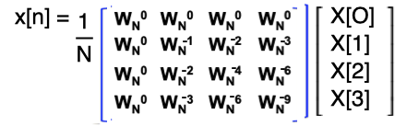
In Matrix Form :
By Substituting :
x[n] =
1 1 1 1
10
-2+2j
-2
-2-2j
1 j -1 -j
1 -1 1 -1
1 j -1 j
x[n] = { 1, 2, 3, 4 }
🡺
ANS
‹#›
Kiran TALELE 99870 30 881 kiran.talele@spit.ac.in
‹#›

Slide 21
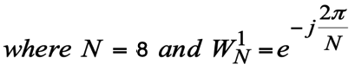
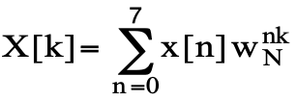
Ex-2. Let x[n] = { 1, 0, 2, 0, 3, 0, 4, 0 } Find X[k]
Solution :
To Find X[k]
By DFT,
Kiran TALELE 99870 30 881 kiran.talele@spit.ac.in
‹#›

Slide 22
X[k] = x[0] + x[1] W_{N}^{k} + x[2] W_{N}^{2k} + x[3] W_{N}^{3k} +
x[4] W_{N}^{4k} + x[5] W_{N}^{5k} + x[6] W_{N}^{6k} + x[7] W_{N}^{7k}
X[k] = 1+ 2 W_{N}^{2k} + 3 W_{N}^{4k} + 4 W_{N}^{6k}
x[n] = 1
0
2
0
3
0
4
0
(i) X[0] = 1 + 2 + 3 + 4
X[0] = 10
(ii) X[1] = 1 + 2 W_{N}² + 3 W_{N}⁴ + 4 W_{N}⁶
= 1 + 2(–j) + 3(–1) + 4(j)
X[1] = –2 + 2j
(iii) X[2] = 1 + 2 W_{N}⁴ + 3 W_{N}⁸ + 4 W_{N}¹²
= 1 + 2(–1) + 3(1) + 4(–1)
X[2] = –2
‹#›
Kiran TALELE 99870 30 881 kiran.talele@spit.ac.in
‹#›

Slide 23
X[k] = 1+ 2 W_{N}^{2k} + 3 W_{N}^{4k} + 4 W_{N}^{6k}
x[n] = 1
0
2
0
3
0
4
0
(iv) X[3] = 1 + 2 W_{N}⁶ + 3 W_{N}¹² + 4 W_{N}¹⁸
= 1 + 2(j) + 3(–1) + 4(–j)
X[3] = –2–2j
(v) X[4] = 1 + 2 W_{N}⁸ + 3 W_{N}¹⁶ + 4 W_{N}²⁴
= 1 + 2(1) + 3(1) + 4(1)
X[4] = 10
(vi) X[5] = 1 + 2 W_{N}¹⁰ + 3 W_{N}²⁰ + 4 W_{N}³⁰
= 1 + 2(–j) + 3(–1) + 4(j)
X[5] = –2 + 2j
vii) X[6] = 1 + 2 W_{N}¹² + 3 W_{N}²⁴ + 4 W_{N}³⁶
= 1 + 2(–1) + 3(1) + 4(–1)
X[6] = –2
‹#›
Kiran TALELE 99870 30 881 kiran.talele@spit.ac.in
‹#›

Slide 24
X[k] = 1+ 2 W_{N}^{2k} + 3 W_{N}^{4k} + 4 W_{N}^{6k}
(viii) X[7] = 1 + 2 W_{N}¹⁴ + 3 W_{N}²⁸ + 4 W_{N}⁴²
= 1 + 2(j) + 3(–1) + 4(–j)
X[7] = –2 – 2j
ANS X[k] = 10 k=0
-2+2j
-2
-2-2j
10
-2+2j
-2
-2-2j
Kiran TALELE 99870 30 881 kiran.talele@spit.ac.in
‹#›

Slide 25

Ex-2 : Find DFT of the following Sequences :
(a) x[n] = { 1, 1, 1, 1 }
(b) x[n] = { 1, 0, 0, 0 }
Solution :
(a) To Find X[k]
(b) To Find X[k]
X[k] =
4 k=0
X[k] =
1 k=0
0
1
0
1
0
1
‹#›
Kiran TALELE 99870 30 881 kiran.talele@spit.ac.in
‹#›

Slide 26
Note :
1. What is the DFT of δ[n] ?
Ans :
2. What is the DFT of N pt signal u[n]
Ans :
DFT { δ[n] } = 1
DFT {u[n] } = N δ[k]
Where
δ[k] =
1 k=0
0
0
- -
- -
‹#›
Kiran TALELE 99870 30 881 kiran.talele@spit.ac.in
‹#›

Slide 27
Ex-3 Find DFT x[n] where
x(n) = { 1, 2, 3, 4 }
Solution :
Step-1 : Find X(w) i.e. DTFT
X(w) = x[-1] e^{jw} + x[o] + x[1] e^{-jw} + x[2] e^{-j2w}
X(w) = e^{jw} + 2 + 3 e^{-jw} + 4 e^{-j2w}
Kiran TALELE 99870 30 881 kiran.talele@spit.ac.in
‹#›

Slide 28
X(w) = e^{jw} + 2 + 3 e^{-jw} + 4 e^{-j2w}
X(w) = Cos(w) + j Sin(w) + 2
+ 3 Cos(w) – 3j Sin(w)
+ 4 Cos(2w) – 4j Sin(2w)
X(w) = [ 2 + 4 Cos(w) + 4 Cos(2w) ]
-j [ 2 Sin(w) + 4 Sin (2w) ]
DTFT of x[n]
Kiran TALELE 99870 30 881 kiran.talele@spit.ac.in
‹#›

Slide 29
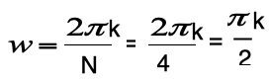
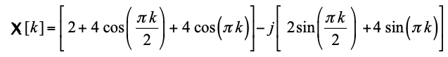
Step-2 : Find X[k] by Sampling X(w)
Now X(w) = [ 2 + 4 Cos(w) + 4 Cos(2w) ]
-j [ 2 Sin(w) + 4 Sin (2w) ]
Put
Kiran TALELE 99870 30 881 kiran.talele@spit.ac.in
‹#›

Slide 30
By evaluating X[k] for k = 0,1, 2, 3 We get,
X[k] =
10 k=0
-2-2j k=1
2 k=2
-2+2j k=3
🡺
ANS
Kiran TALELE 99870 30 881 kiran.talele@spit.ac.in
‹#›

Slide 31
Properties of DFT
[1] Scaling and Linearity Property
If x₁[n] 🡪 X₁[k]
x₂ [n] 🡪 X₂[k]
Then
DFT { a x₁[n] + b x₂[n] } = { a X₁[k] + b X₂[k] }
Kiran TALELE 99870 30 881 kiran.talele@spit.ac.in
‹#›

Slide 32
Ex. Let x[n] = { 1, 2, 3, 4 }
Find X[k]
Solution :
(a) To Find X[k]
Formula
(ii) Matrix Representation
(iii) Matrix Substitution
(iv) Matrix Multiplication
X[k] =
10 k=0
-2+2j
-2
-2-2j
🡺
ANS
Kiran TALELE 99870 30 881 kiran.talele@spit.ac.in
‹#›

Slide 33
(b) Let p[n] = 2 δ[n] + x[n] Find P[k] using X[k]
Solution (b) : To find P[k] using X[k]
p[n] = 2 δ[n] + x[n]
By Linearity Property of DFT,
P[k] = 2 DFT{ δ[n] } + DFT{ x[n] }
P[k] = 2 { 1 } + X[k]
Kiran TALELE 99870 30 881 kiran.talele@spit.ac.in
‹#›

Slide 34
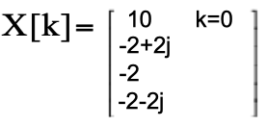
P[k] = 2 + X[k] where
=====================
k=0, P[0] = 2 + X[0]
== 12
k=1, P[1] = 2 + X[1]
== 2j
k=2, P[2] = 2 + X[2]
== 0
k=3, P[3] = 2 + X[3]
== -2j
P[k] =
12 k=0
Ans :
2j
0
-2j
Kiran TALELE 99870 30 881 kiran.talele@spit.ac.in
‹#›

Slide 35
(C) Let q[n] = 2 + x[n] Find Q[k] using X[k]
Solution (c):
To find Q[k] using X[k]
Now, q[n] = 2 + x[n]
q[n] = 2 { 1 } + x[n]
Let, q[n] = 2 { u[n] } + x[n]
By Linearity Property of DFT,
Q[k] = 2 DFT { u[n] } + DFT{ x[n] }
Kiran TALELE 99870 30 881 kiran.talele@spit.ac.in
‹#›

Slide 36
Q[k] = 2 DFT { u[n] } + DFT{ x[n] }
Q[k] = 2 { 4 δ[k] } + X[k]
1
10
Q[k] = 8 { } + { }
0
-2+2j
0
-2
0
-2-2j
Q[k] =
18 k=0
-2+2j
🡺
ANS
-2
-2-2j
Kiran TALELE 99870 30 881 kiran.talele@spit.ac.in
‹#›

Slide 37
HW-1. Let X[k] be 4 point DFT of x[n] with
X[k] ={ 1, 2, 3, 4 }.
Find 4 point DFT of p[n] such that
p[n] = 2 + 3 δ[n] + 4 x[n]
HW-2. Let x[n] = { 1, 2, 3, 4 } and x[n] 🡨🡪 X[k].
Find inverse DFT of the following without
using DFT/iDFT equations.
(a) P[k] = 8 X[K] (b) Q[k] = 8 + X[k]
Kiran TALELE 99870 30 881 kiran.talele@spit.ac.in
‹#›

Slide 38
[2] Periodicity Property
If x[n] 🡪 X[k]
Then
(i) x[n] = x[n+N] i.e. x[n] is periodic
= x[n Mod N]
= x[((n))] _{N}
(ii) X[k] = X[k+N] i.e. X[k] is periodic
= X[k Mod N]
= X[((k))] _{N}
NOTE :
Both DFT and IDFT equations produce periodic results with period = N.
Kiran TALELE 99870 30 881 kiran.talele@spit.ac.in
‹#›

Slide 39

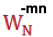
[3] Time Shift Property
If x[n] 🡪 X[k]
Then
DFT { x[n - m] } =
X[k]
[4] Frequency Shift Property
If x[n] 🡪 X[k]
Then
DFT { x[n] } =
X[ k-m ]
Kiran TALELE 99870 30 881 kiran.talele@spit.ac.in
‹#›

Slide 40
Ex. Let x[n] = { 1, 2, 3, 4 }
Find X[k]
Solution :
(a) To Find X[k]
X[k] =
10 k=0
-2+2j
-2
-2-2j
🡺
ANS
Kiran TALELE 99870 30 881 kiran.talele@spit.ac.in
‹#›

Slide 41
(b) Let p[n] = { 4, 1, 2, 3 }. Find P[k] using X[k].
Solution :
(b) To find P[k]
Now, x[n] = { 1, 2, 3, 4 }
Given p[n] = { 4, 1, 2, 3 }
By comparing x[n] and p[n] we get,
p[n] = x[n-1]
Kiran TALELE 99870 30 881 kiran.talele@spit.ac.in
‹#›

Slide 42

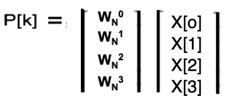
Now p[n] = x[n – 1]
Time Shift
Property of DFT
DFT {x[n-m]} =
W_{N}^{mk} X[k]
By Time Shift Property of DFT,
P[k] = X[k]
j
-1
1
-j
P[k] =
1
10
P[k] =
10 k=0
2+2j
2
2-2j
- j
-2+2j
- 1
-2
j
-2-2j
Kiran TALELE 99870 30 881 kiran.talele@spit.ac.in
‹#›

Slide 43
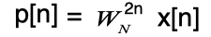
(c) Let p[n] = ( – 1 )^{n} x[n] Find P[k] using X[k].
Solution (b): To find P[k]
Given p[n] = ( – 1 )^{n} x[n]
j
-1
1
For N = 4, = -1
-j
By Substituting,
Frequency Shift Property of DFT
DFT {W_{N}^{-mn} x[n]}
==X[k-m]
By Frequency Shift Property of DFT,
P[k] = X[k+2]
Kiran TALELE 99870 30 881 kiran.talele@spit.ac.in
‹#›

Slide 44
Solution (b): To find P[k]
Given p[n] = ( – 1 )^{n} x[n]
j
For N = 4, = -1
-1
1
-j
By Substituting,
By Frequency Shift Property of DFT,
P[k] = X[k+2]
X[k] =
10 k=0
-2+2j k=1
-2 k=2
-2-2j k=3
P[k] =
-2 k=0
-2-2j
10
-2+2j
Kiran TALELE 99870 30 881 kiran.talele@spit.ac.in
‹#›

Slide 45
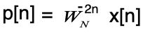
EX-2. Let x[n] = {1, 2, 3, 4}.
Find the Inverse DFT of the following
sequences without using using DFT/iDFT
equation. Given (a) X[k-2] (b) X[k+2]
Solution (a): To find Inverse DFT { X[k-2] }
Let P[k] = X[k-2]
Frequency Shift Property of DFT
DFT {W_{N}^{-mn} x[n]}
==X[k-m]
By Frequency Shift Property
of IDFT,
p[n] = ( – 1 )^{n} x[n]
ANS : p[n] = { 1, -2, 3, -4 }
ANS
🡺
Kiran TALELE 99870 30 881 kiran.talele@spit.ac.in
‹#›

Slide 46
Solution (b): To find Inverse DFT { X[k+2] }
Frequency Shift Property of DFT
DFT {W_{N}^{-mn} x[n]}
==X[k-m]
Let P[k] = X[k+2]
By Frequency Shift Property
of IDFT,
p[n] = ( – 1 )^{n} x[n]
Here,
x[n] = {1, 2, 3, 4}
ANS : p[n] = { 1, -2, 3, -4 }
Kiran TALELE 99870 30 881 kiran.talele@spit.ac.in
‹#›

Slide 47
HW-1. Find the DFT of the following
sequences :
(a) x[n] = cos(0.5 π n )
(b) x[n] = sin (0.25 π n)
Hint :
1. Calculate one Period of Periodic x[n]
2. Calculate X[k] by DFT
Kiran TALELE 99870 30 881 kiran.talele@spit.ac.in
‹#›

Slide 48
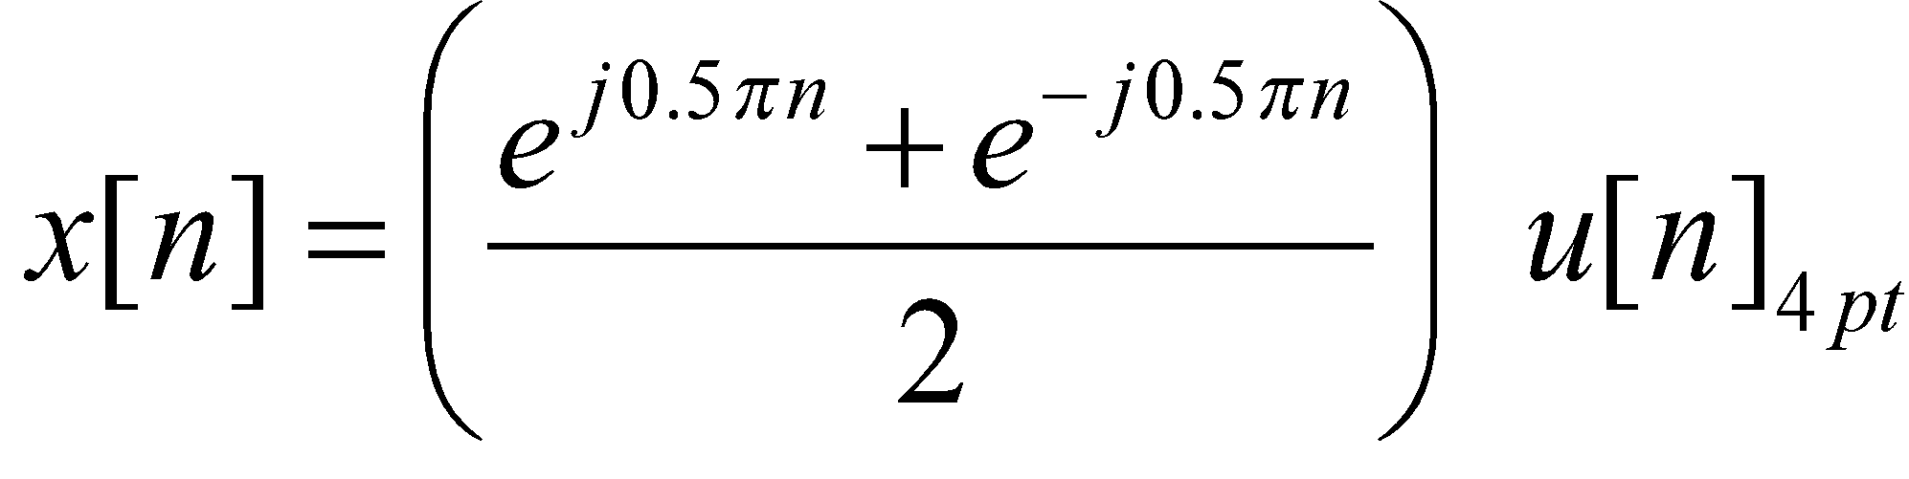
HW-2. Find the DFT of the following
sequences :
(a) x[n] = cos(0.5 π n ) u[n]
(b) x[n] = sin (0.25 π n) u[n]
Hint :
1. Let
2. Calculate X[k] by Frequency
Shift Property of DFT
Kiran TALELE 99870 30 881 kiran.talele@spit.ac.in
‹#›

Slide 51
[5] Time Reversal Property
If x[n] 🡪 X[k]
Then
DFT { x[- n ] } = X[ - k ]
= X[ - k + N ]
= X[ N – k ]
Kiran TALELE 99870 30 881 kiran.talele@spit.ac.in
‹#›

Slide 52
Ex. Let x[n] = { 1, 2, 3, 4 }
(a) Find X[k]
(b) Let p[n] = { 1, 4, 3, 2 } Find P[k] using X[k]
Solution (a) To Find X[k] :
X[k] =
10 k=0
-2+2j k=1
-2 k=2
-2-2j k=3
🡺
ANS
Kiran TALELE 99870 30 881 kiran.talele@spit.ac.in
‹#›

Slide 53
Solution (b): To find P[k]
Given p[n] = { 1, 4, 3, 2 }
x[n] = { 1, 2, 3, 4 }
p[n] = { 1, 4, 3, 2 }
By comparing p[n] and x[n]
we get,
p[n] = x[-n]
Time Reversal Property of DFT
DFT {x[-n]} = X[-k]
By Time Reversal Property of DFT,
P[k] = X[-k]
P[k] =
10 k=0
-2-2j
-2
-2+2j
X[k] =
10 k=0
-2+2j k=1
-2 k=2
-2-2j k=3
Kiran TALELE 99870 30 881 kiran.talele@spit.ac.in
‹#›

Slide 54
Ex-2 Let X[k] = {1, 2, 3, 4}.
Find the DFT of the following sequences
using X[k] and not otherwise
(a) x[-n] (b) x[–n+1] (c) x[-n-1]
Solution (a): To find DFT { x[-n]}
Let p[n] = x[-n]
By Time Reversal Property of DFT,
P[k] = X[-k]
P[k] =
k=0
4
3
2
X[k] =
10 k=0
-2+2j k=1
-2 k=2
-2-2j k=3
🡺
ANS
1 k=0
2 k=1
3 k=2
4 k=3
Kiran TALELE 99870 30 881 kiran.talele@spit.ac.in
‹#›

Slide 55
Solution (b): To find DFT { x[-n+1] }
Let p[n] = x[-n]
Time Shift Property of DFT
DFT { x[n-m]} = W_{N}^{mk} X[k]
Replace ( n ) by ( n-1 )
p[n-1] = x[ -(n-1) ]
p[n-1] = x[ -n+1 ]
By DFT,
DFT (p[n-1]) = DFT(x[-n+1])
Kiran TALELE 99870 30 881 kiran.talele@spit.ac.in
‹#›

Slide 56
To find DFT { x[-n+1] }...
Time Shift Property of DFT
DFT { x[n-m]} = W_{N}^{mk} X[k]
DFT ( x[-n+1] ) = DFT( p[n-1] )
By Time Shift Property of DFT,
DFT ( x[-n+1] ) = P[k]
DFT ( x[-n+1] ) = X[-k]
DFT ( x[-n+1] ) =
1
-j
-1
-j
=
🡺
ANS
1
4
3
2
1 k=0
-4j
-3
-2j
Kiran TALELE 99870 30 881 kiran.talele@spit.ac.in
‹#›

Slide 57
Solution (c): To find DFT { x[-n-1] }
HW
Kiran TALELE 99870 30 881 kiran.talele@spit.ac.in
‹#›

Slide 58
[6] Symmetry Property
If x[n] is Real valued sequence
Then
X[k] =
X*[ - k ]
=
X*[ - k + N ]
=
X*[ N – k ]
Kiran TALELE 99870 30 881 kiran.talele@spit.ac.in
‹#›

Slide 59
Ex-1 The first five points of the eight point DFT of a real valued sequence are
X[k] = { 25, 0.12 – j 0.30, 6.4, 0.20 + j 0.18, 10 }. Determine the remaining three points.
Solution :
Here x[n] is real valued N=8 point DT Signal.
By symmetry property of DFT,
If DFT { x[n] } = X[k]
Then
X[k] = X*[-k]
X[k] = X*[N-k]
Kiran TALELE 99870 30 881 kiran.talele@spit.ac.in
‹#›

Slide 60
By symmetry property of DFT,
If DFT { x[n] } = X[k]
Then
X[k] = X*[-k]
= X*[N-k]
X[k] = X*[8-k]
X[k] = 25 k=0
0.12 – j 0.30 k=1
6.4 k=2
0.20+ j 0.18 k=3
10 k=4
k=5
k=6
k=7
=================
k=5, X[5] = X*[3]
= 0.20 - j 0.18
k=6, X[6] = X*[2]
= 6.4
k=7, X[7] = X*[1]
= 0.12 + j 0.30
Kiran TALELE 99870 30 881 kiran.talele@spit.ac.in
‹#›

Slide 61
By symmetry property of DFT,
If DFT { x[n] } = X[k]
Then
X[k] = X*[-k]
= X*[N-k]
X[k] = X*[8-k]
Answer :
X[k] = 25 k=0
0.12 – j 0.30 k=1
6.4 k=2
0.20+ j 0.18 k=3
10 k=4
0.20 - j 0.18 k=5
6.4 k=6
0.12 + j 0.30 k=7
=================
k=5, X[5] = X*[3]
= 0.20 - j 0.18
k=6, X[6] = X*[2]
= 6.4
k=7, X[7] = X*[1]
= 0.12 + j 0.30
Kiran TALELE 99870 30 881 kiran.talele@spit.ac.in
‹#›

Slide 62
NOTE:
X[k] = 25 k=0
0.12 – j 0.30 k=1
6.4 k=2
0.25+ j 0.18 k=3
10 k=4
0.25 - j 0.18 k=5
6.4 k=6
0.12 + j 0.30 k=7
NOTE:
If x[n] is Real valued sequence,
Then
Real { X[k] } is Symmetric @ k = N/2
And
Imaginary {X[k]} is Anti-Symmetric @ k = N/2
Kiran TALELE 99870 30 881 kiran.talele@spit.ac.in
‹#›

Slide 63
Ex-2 The Find the unknown values of x[n] and X[k]
x[n] = { ? , 3, -4, 0, 2 }
X[k] = { 5, ?, -1.28+4.39j , ?, 8.78–1.4j }
x[n] = { 2 , 3, -4, 2, 0, 1}
X[k] = { 4, ?, 4–5.2j, -8 , ?, 4+1.73 j }
Kiran TALELE 99870 30 881 kiran.talele@spit.ac.in
‹#›

Slide 64
[7] Even Signal Property
If x[n] = x[-n]
Then X[k] = X[-k]
Even
Even
[8] Odd Signal Property
If x[n] = - x[-n]
Then X[k] = - X[-k]
Odd
Odd
Kiran TALELE 99870 30 881 kiran.talele@spit.ac.in
‹#›

Slide 65
Ex-1 : Let x[n]= { 1, 2, 3, 4 }
(a) Find X[k].
(b) Find DFT of x_{e}[n] and x_{o}[n]
using X[k] and not otherwise
Solution (a) To Find X[k] :
X[k] =
10 k=0
-2+2j
-2
-2-2j
🡺
ANS
Kiran TALELE 99870 30 881 kiran.talele@spit.ac.in
‹#›

Slide 66
Solution : To find DFT of x_{e}[n] using X[k]
x_{e}[n] = ½ ( x[n] + x[-n] )
x[n] = x_{e}[n] + x₀[n]
By Linearity Property of DFT,
x_{e}[n]= ½ (x[n] + x[-n])
x₀[n]= ½ (x[n] - x[-n])
X_{e}[k] = ½ ( X[k] + X[-k] )
(
+
)
X_{e}[k] = ½
10
-2+2j
-2
-2-2j
10
-2-2j
-2
-2+2j
X[k]=
10 k=0
-2+2j
-2
-2-2j
X_{e}[k] =
10 k=0
-2
- 2
- 2
Xe[k] = Real part of X[k]
This is valid only for real valued sequence x[n]
Kiran TALELE 99870 30 881 kiran.talele@spit.ac.in
‹#›

Slide 67
Solution : To find DFT of x_{o}[n] using X[k]
x₀[n] = ½ ( x[n] - x[-n] )
x[n] = x_{e}[n]+x₀[-n]
By Linearity Property of DFT,
x_{e}[n]=0.5(x[n] + x[-n])
x₀[n]=0.5(x[n] - x[-n])
X_{o}[k] = ½ ( X[k] - X[-k] )
(
-
)
X_{o}[k] = ½
10
-2+2j
-2
-2-2j
10
-2-2j
-2
-2+2j
10 k=0
-2+2j
-2
-2-2j
X[k] =
X_{o}[k] =
0 k=0
-2j
0
-2j
Xo[k] = Imaginary part of X[k]
This is valid only for real valued sequence x[n]
Kiran TALELE 99870 30 881 kiran.talele@spit.ac.in
‹#›

Slide 68
[9] Complex Conjugate Sequence Property
If x[n] 🡪 X[k]
Then
DFT { x*[ n ] } =
X*[ - k ]
Kiran TALELE 99870 30 881 kiran.talele@spit.ac.in
‹#›

Slide 69
x[n] =
Ex : Let
1 + j n=0
2 + 2j
3 + 3j
4 + 2j
Find X[k].
Let p[n] = { 1,2,3,4} and q[n] = { 1,2,3,2}
Find P[k] and Q[k] using X[k]
Solution (a) To Find X[k] :
By DFT,
Kiran TALELE 99870 30 881 kiran.talele@spit.ac.in
‹#›

Slide 70
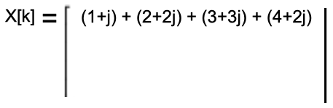
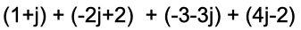
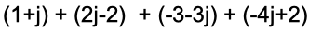
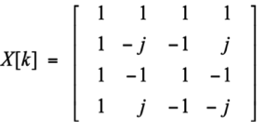
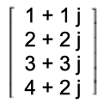
In Matrix Form :
By Substituting :
X[k] =
10 + 8j k=0
-2 k=1
-2 k=2
-2 - 4j k=3
🡺
ANS
‹#›
Kiran TALELE 99870 30 881 kiran.talele@spit.ac.in
‹#›

Slide 71
(b) Let p[n] = { 1, 2, 3, 4} and q[n] = { 1, 2, 3, 2}
Find P[k] and Q[k] using X[k]
Solution (b) To Find P[k] and Q[k]
x[n] =
1 + 1 j
2 + 2 j
3 + 3 j
4 + 2 j
Let x[n] = p[n] + q[n] j
‹#›
Kiran TALELE 99870 30 881 kiran.talele@spit.ac.in
‹#›

Slide 72
To Find P[k] using X[k]
Now, x[n] = p[n] + j q[n] ….. (I)
By Complex Conjugate on both sides :
x*[n] = p[n] – j q[n] ….. (II)
====================================
Adding (I) and (II) we get;
x[n] + x*[n] = 2 p[n]
So, p[n] = ½ ( x[n] + x*[n] )
‹#›
Kiran TALELE 99870 30 881 kiran.talele@spit.ac.in
‹#›

Slide 73
To Find P[k] using X[k].. .. ..
Now, p[n] = ½ ( x[n] + x*[n] )
By Linearity & Complex Conjugate Property of DFT,
P[k] = ½ ( X[k] + X*[-k] )
(
)
P[k] = ½
10+8j
-2
-2
-2-4j
+
10-8j
-2+4j
-2
-2
P[k] =
10 k=0
-2+2j
-2
-2-2j
🡺
ANS
‹#›
Kiran TALELE 99870 30 881 kiran.talele@spit.ac.in
‹#›

Slide 74
To Find Q[k] using X[k]
Now, x[n] = p[n] + j q[n] ….. (I)
By Complex Conjugate on both sides :
x*[n] = p[n] – j q[n] ….. (II)
====================================
By (I) - (II) we get;
x[n] - x*[n] = 2j q[n]
So, q[n] = ¹/2j ( x[n] - x*[n] )
‹#›
Kiran TALELE 99870 30 881 kiran.talele@spit.ac.in
‹#›

Slide 75
To Find Q[k] using X[k].. .. ..
Now, q[n] = ¹/2j ( x[n] - x*[n] )
By Linearity & Complex Conjugate Property of DFT,
Q[k] = ¹/2j ( X[k] - X*[-k] )
(
)
Q[k] = ¹/2j
10+8j
-2
-2
-2-4j
-
10-8j
-2+4j
-2
-2
Q[k] =
8 k=0
-2
0
-2
ANS
🡺
‹#›
Kiran TALELE 99870 30 881 kiran.talele@spit.ac.in
‹#›

Slide 76
[10] Circular Convolution Property
If x[n] 🡪 X[k]
And h[n] 🡪 H[k]
Then
DFT { x[n ] h[n]} =
⊗
X[k] H[k]
Circular Convolution in Time Domain
Multiplication in Frequency Domain
Kiran TALELE 99870 30 881 kiran.talele@spit.ac.in
‹#›

Slide 77
Ex-1 Let x[n] = [ 1, 2, 3, 4 } and h[n] = { 5, 6, 7 }
Find Circular Convolution using DFT
Solution :
Here x[n] is L= 4 point and h[n] is M = 3 point
Select N
N = Max (L,M)
N = Max (4,3) == 4
II. Zero Padding
x[n] = [ 1, 2, 3, 4 }
h[n] = { 5, 6, 7, 0 }
Kiran TALELE 99870 30 881 kiran.talele@spit.ac.in
‹#›

Slide 78
III Find y[n] = x[n] ⊗ h[n] using DFT
Now, Y[k] = X[k] H[k]
By Circular Convolution Property
of IDFT ,
y[n] = x[n] ⊗ h[n]
ALGORITHM:
X[k]
x[n]
N pt
DFT
Y[k]
y[n]
IDFT
N pt
h[n]
N pt
DFT
H[k]
Kiran TALELE 99870 30 881 kiran.talele@spit.ac.in
‹#›

Slide 79


(1) Find X[k]
(2) Find H[k]
By DFT,
By DFT,
X[k] =
1 1 1 1
H[k] =
1 1 1 1
5
6
7
0
1
2
3
4
1 -j -1 j
1 -j -1 j
1 -1 1 -1
1 -1 1 -1
1 j -1 -j
1 j -1 -j
X[k] =
H[k] =
10 k=0
-2+2j
-2
-2-2j
18 k=0
-2-6j
6
-2+6j
Kiran TALELE 99870 30 881 kiran.talele@spit.ac.in
‹#›

Slide 80

(3) Find Y[k]
(4) Find y[n]
Y[k] = X[k] H[k]
Y[k] =
10
18
-2-2j
-2-6j
y[n] =
1 1 1 1
180
16+8j
-12
16-8j
1 j -1 -j
-2
6
1 -1 1 -1
-2+2j
-2+6j
1 -j -1 j
Y[k] =
180 k=0
y[n] =
50 n=0
16+8j
🡺
ANS
44
-12
34
16-8j
52
Kiran TALELE 99870 30 881 kiran.talele@spit.ac.in
‹#›

Slide 81
Ex-2 Let x[n] = [ 1, 2, 3 } and h[n] = { 5, 6 }
Find Linear Convolution using DFT
Solution :
Here x[n] is L= 3 point and h[n] is M = 2 point
Select N
N ≥ L+M -1
N ≥ 3+2-1 == 4
II. Zero Padding
x[n] = [ 1, 2, 3, 0 }
h[n] = { 5, 6, 0, 0 }
Kiran TALELE 99870 30 881 kiran.talele@spit.ac.in
‹#›

Slide 82
III Find y[n] = x[n] ⊗ h[n] using DFT
Now, Y[k] = X[k] H[k]
By Circular Convolution Property
of IDFT ,
y[n] = x[n] ⊗ h[n]
ALGORITHM:
X[k]
x[n]
N pt
DFT
Y[k]
y[n]
IDFT
N pt
h[n]
N pt
DFT
H[k]
Kiran TALELE 99870 30 881 kiran.talele@spit.ac.in
‹#›

Slide 83
(1) Find X[k]
(2) Find H[k]
By DFT,
By DFT,
X[k] =
1 1 1 1
H[k] =
1 1 1 1
5
6
0
0
1
2
3
0
1 -j -1 j
1 -j -1 j
1 -1 1 -1
1 -1 1 -1
1 j -1 -j
1 j -1 -j
X[k] =
H[k] =
6 k=0
-2-2j
2
-2+2j
11 k=0
5-6j
-1
5+6j
Kiran TALELE 99870 30 881 kiran.talele@spit.ac.in
‹#›

Slide 84
(3) Find Y[k]
(4) Find y[n]
Y[k] = X[k] H[k]
Y[k] =
6
-2-2j
2
-2+2j
11
5-6j
-1
5+6j
y[n] =
1 1 1 1
66
-22+2j
-2
-22-2j
1 j -1 -j
1 -1 1 -1
1 -j -1 j
Y[k] =
y[n] =
66 k=0
-22+2j
-2
-22-2j
5 n=0
16
27
18
🡺
ANS
Kiran TALELE 99870 30 881 kiran.talele@spit.ac.in
‹#›

Slide 85


🡺 Parseval’s Energy Theorem
Energy in Time Domain
Energy in
Frequency Domain
==
(i) Energy in Time Domain :
(ii) Energy in Frequency Domain :
Kiran TALELE 99870 30 881 kiran.talele@spit.ac.in
‹#›

Slide 86
Ex. Let x[n] = { 1, 2, 3, 2 }
(i) Find Energy in Time Domain :
E = (1)² + (2)² + (3)³ + (2)²
E = 18
(ii) Find Energy in Frequency Domain :
Kiran TALELE 99870 30 881 kiran.talele@spit.ac.in
‹#›

Slide 87
To Find X[k]
X[k] =
8 k=0
-2
0
-2
To Find Energy :
E = ¼ { (8)² + (-2)² + (0)³ + (-2)² }
E = 18
Kiran TALELE 99870 30 881 kiran.talele@spit.ac.in
‹#›

Slide 88
Summary :

Slide 89
* Find Complex Multiplications and Complex additions in DFT
By DFT,
Total Complex Multi = N²
Total Complex Additions = N² – N
Kiran TALELE 99870 30 881 kiran.talele@spit.ac.in
‹#›

Slide 90
* Find Real Multiplications and Real additions in DFT
By DFT,
Total Complex Multi = N²
Total Complex Additions = N² – N
Kiran TALELE 99870 30 881 kiran.talele@spit.ac.in
‹#›

Slide 91
Let P = a + j b and Q = c + j d
For 1 Complex Multi :
4 Real Multi
2 Real Additions
(1) P X Q = ( a + j b ) ( c + j d )
= (ac – bd )+ j ( bc + ad )
For 1 Complex Multiplication we require,
4 Real Multiplications and
2 Real Additions
For 1 Complex Additions :
2 Real Additions
(2) P + Q = ( a + j b ) + ( c + j d )
= (a + c )+ j ( b + d )
For 1 Complex Addition we require 2 Real Additions
Kiran TALELE 99870 30 881 kiran.talele@spit.ac.in
‹#›

Slide 92
In DFT,
(1) Total Complex Multi = N²
For N² Complex Multiplications
we require
4 N² Real Multiplications
2 N² Real Additions …..(I)
(2) Total Complex Additions = N² ⁻N
For N²–N Complex Additions
we require 2 (N²-N) = 2N² - 2N Real Additions----(II)
(3) Adding (I) and (II) we get
Total Real Additions = 2N² + 2N²-2N == 4N²-2N
For 1 Complex Multi :
4 Real Multi
2 Real Additions
For 1 Complex Additions :
2 Real Additions
Kiran TALELE 99870 30 881 kiran.talele@spit.ac.in
‹#›

Slide 93


By DFT :-
(i) Total Real Multiplications = 4 N²
(ii) Total Real Additions = 4 N² - 2 N
By FFT :-
Total Real Multiplications
Total Real Additions
Kiran TALELE 99870 30 881 kiran.talele@spit.ac.in
‹#›

Slide 94

December 21, 1807
“Any arbitrary function, continuous or with discontinuities, defined in a finite interval by an arbitrarily capricious graph can always be expressed as a sum of sinusoids”
Jean Fourier
(1768-1830)
Kiran TALELE 99870 30 881 kiran.talele@spit.ac.in
‹#›
Notes:
He announced these results in a prize paper on the theory of heat.
The judges: Laplace, Lagrange and Legendre
Three of the judges found it incredible that sum of sines and cosines could add up to anything but an infinitely differential function, but...
Lagrange: Lack of mathematical rigor and generality
Denied publication….
After 15 years, following several attempts and disappointments and frustration, he published his results in Theorie Analytique de la Chaleur in 1822 (Analytical Theory of Heat).
In 1829, Dirichlet proved Fourier’s claim with very few and non-restricting conditions.
Next 150 years: His ideas expanded and generalized. 1965: Cooley and Tukey--> Fast Fourier Transform==> Computational simplicity==>King of all transforms…Many applications engineering, finance, etc.

Slide 95


Stay Connected……..
Mobile : 091-9987030881
eMail : talelesir@gmail.com
ktvtalele@gmail.com
kiran.talele@spit.ac.in
Facebook : www.facebook.com/ Kiran-Talele-1711929555720263
Linkedln : https://www.linkedin.com/in/k-t-v-talele/
Kiran TALELE
DoB :13-01-1968
‹#›

Slide 96
Dr. Kiran TALELE is an Associate Professor in Electronics & Telecommunication Engineering Department of Bharatiya Vidya Bhavans’ Sardar Patel Institute of Technology, Mumbai with 33+ years experience in Academics.
He is a Dean of Students, Alumni and External Relations at Sardar Patel Institute of Technology, Andheri Mumbai.
He is also a Head of Sardar Patel Technology Business Incubator, Mumbai.
His area of research is Digital Signal & Image Processing, Computer Vision, Machine Learning and Multimedia System Design.
He has published 85+ research papers at various national & international refereed conferences and journals. He has published 22 patents at Indian Patent Office. One patent is granted in 2021.
He is a Treasurer of IEEE Bombay Section and Mentor for Startup Incubation & Intellectual Asset Creation.
He received incentives for excellent performance in academics and research from Management of S.P.I.T. in 2008-09. He is a recipient of P.R. Bapat IEEE Bombay Section Outstanding Volunteer Award 2019.

Slide 97




Thank you

